Slide 1


Crop Planning & Farm Input
Management System
A normalized 3NF relational database architecture and data entry interface for tracking agronomic lifecycle, inputs, labour, harvest yield, and crop profitability.

Slide 2

System Scope & Objectives
End-to-End Farm Lifecycle
Agricultural enterprises require granular tracking across distinct operations: soil viability, seasonal crop plans, nutrient and pesticide applications, labour allocation, and market sales.
Without an integrated relational system, records remain fragmented in disparate logs. This DBMS reconciles variable cultivation costs against final market yields to empower data-driven agronomy.

Slide 3




User Roles & Access Control
Farm Administrator
Agronomist & Planner
Field Supervisor
Sales & Finance Officer
Configures system parameters, provisions user credentials, registers new farm plots, defines season dates, and manages inventory categories.
Records soil chemical analyses, schedules crop plans, specifies recommended input rates, plans irrigation cycles, and assesses yield health.
Logs daily application events, records irrigation water volume, enters worker labour hours and wages, and inputs raw harvest weights.
Manages commercial buyer profiles, generates sales invoices, monitors inventory dispatch, and audits field expenditure versus revenue.

Slide 4


Conceptual Schema & Entities
Land, Crop & Planning Entities
Operations, Yield & Sales Entities
•
Farm & Field: Represents spatial boundaries, total arable acreage, and geographic coordinates.
•
Input & Application: Fertilizers and chemicals mapped to field applications and dosage.
•
Season: Temporal framework bounded by strict operational start and end calendar dates.
•
Irrigation Event: Source, pump duration, and calculated water volume (m³) per plot.
•
Crop & Variety: Botanical classification, growth stages, days to maturity, and seed attributes.
•
Labour Activity: Operation classification (weeding, pruning), hours logged, and rate.
•
Soil Test: Historical records of N-P-K levels, pH balance, and organic content per field.
•
Harvest Record: Yield batch grading, total weight (kg), and storage location.
•
Crop Plan: Associative entity scheduling a specific variety onto a field for a planned season.
•
Buyer & Sales Transaction: Commercial entity dispatch records and realised price per unit.

Slide 5

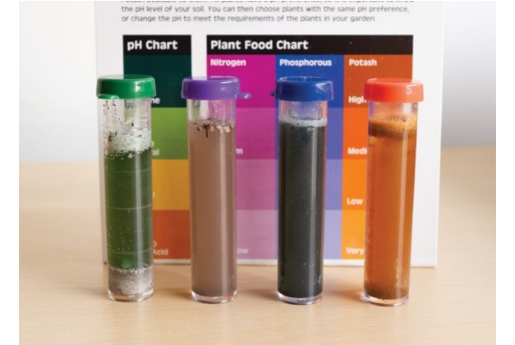
Agronomic Integrity & Soil Data
•
Soil health metrics directly govern prescriptive input recommendations across all registered field zones.
•
Each Soil_Test record enforces non-null parameters for nitrogen, phosphorus, potassium, and pH (3.5 to 9.5 range).
•
Historical test records are linked via foreign keys to the Field entity, preventing orphaned soil reports.
•
Application algorithms cross-reference soil test thresholds to flag chemical over-application before execution.

Slide 6
Integrity Constraints & Rules
Temporal Bounding Constraints Crop planting and harvest dates must strictly fall within the parent season's valid start_date and end_date window.
Positive Quantity Assertions CHECK (quantity > 0) enforced on all inputs applied, irrigation water volume, and daily work hours recorded.
Non-Negative Harvest Bounds Harvest yields must be non-negative: CHECK (yield_quantity >= 0) and cannot precede the actual planting date.
Inventory Stock Validations Sales transactions cannot exceed available in-stock produce: sold_qty <= (total_harvested - previously_sold).

Slide 7

Relational Schema Normalization
Table Name | Primary Key (PK) | Foreign Keys (FK) | 3NF Elimination Strategy
Crop_Plan | plan_id | field_id, variety_id, season_id | Separated variety details from plans to eliminate partial functional dependencies.
Input_Application | application_id | plan_id, input_id, supervisor_id | Removed supplier details and unit pricing; placed in decoupled Farm_Input entity.
Labour_Log | log_id | plan_id, worker_id, activity_id | Decomposed worker daily rates from field logs to remove transitive wage dependencies.
Sale_Item | sale_item_id | sale_id, harvest_id | Decoupled customer billing and tax from individual batch produce line items.

Slide 8

System Architecture Metrics
ACID Compliance & Indexing
3NF
Implemented on PostgreSQL and MySQL InnoDB to guarantee atomicity during multi-table sales and stock inventory adjustments.
B-Tree composite indexes applied on (plan_id, application_date) and (harvest_id, sale_date) to accelerate join queries and analytical reporting pipelines.
Strict Normalization Standard

Slide 9
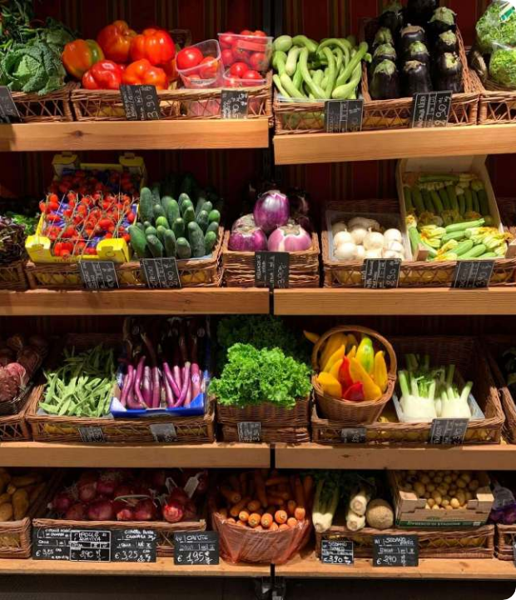
Harvest & Sales Tracking
Traceable Batch Fulfillment
Each harvested batch is catalogued by quality grade, moisture percentage, and storage silo. This provides complete provenance from specific field plots to commercial buyers.
Sales workflows dynamically decrement real-time stock levels, ensuring zero overselling while automatically computing net profitability per crop variety.

Slide 10
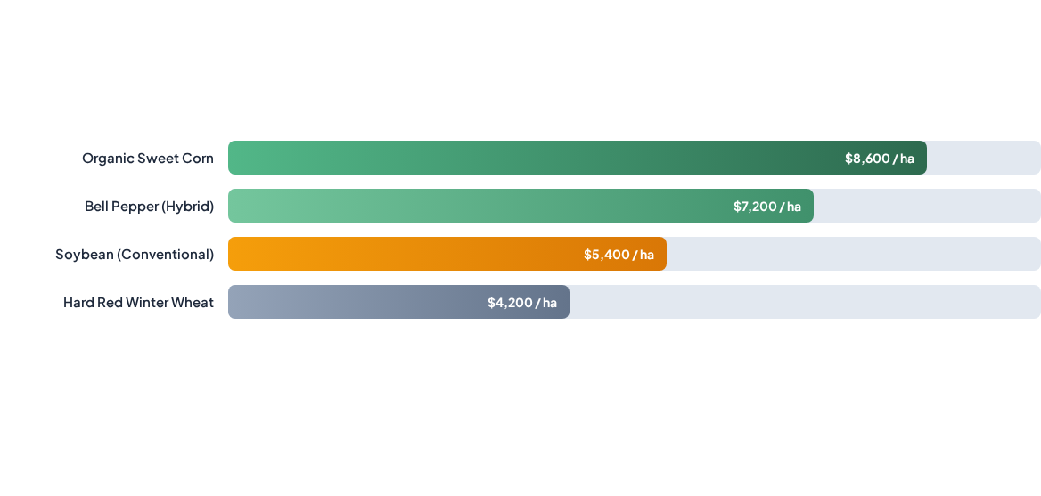
Crop Margin & Cost vs. Yield
SQL analytical views aggregate fertilizer inputs, irrigation utility bills, and labor hours against gross sales to surface net crop margin per hectare.

Slide 11


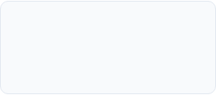
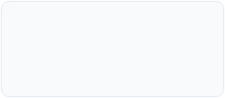
Implementation Milestones
2. DDL & Constraints
4. Views & Audits
Database table creation with foreign keys, CHECK triggers, and sample data population.
Complex reporting views, cost-yield analytics, transaction audits, and query optimization.
1. Schema & ERD
3. Front-End App
Entity identification, Crow's Foot ER modeling, and conversion into 3NF normalized tables.
Development of Python/Java data entry forms for soil tests, plans, and harvest logs.

Slide 12



Questions & Discussion
A demonstration of relational modeling, business integrity rules, and database-backed decision making for modern agronomic systems.

Slide 13



Image Sources
https://www.farmerp.com/wp-content/uploads/2025/12/Blog_Images_Farm_ERP-01-1024x536.jpg
Source: www.farmerp.com
https://landresources.montana.edu/soilfertility/images/SoilTestKit.jpg
Source: landresources.montana.edu
https://fruitgrowers.com/wp-content/uploads/2019/05/assorted-fruits-on-brown-wooden-racks-1-1000x750.jpg
Source: fruitgrowers.com

